Slide 1
Member Cancellation Prediction
Pham Anh Dung

Slide 2
Agenda
Problem Understanding
Exploration Data Analysis
Predictive Analytics
Proposed Solution Deployment

Slide 3

Problem Understanding

Slide 4
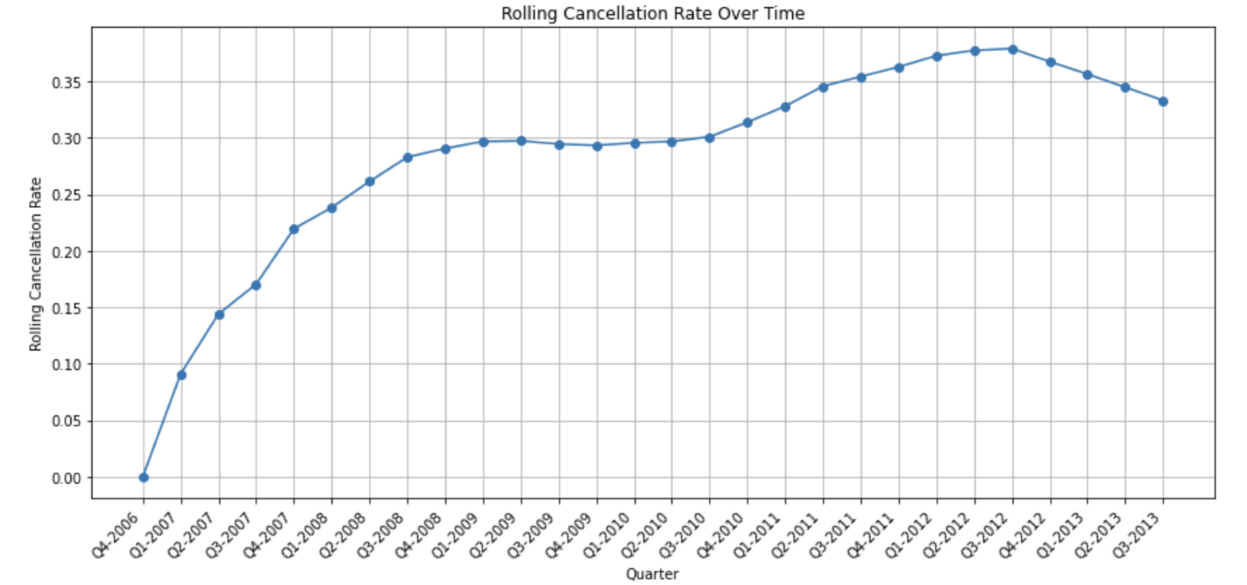
Problem Definition
Problem understanding
The chart presented below illustrates the cancellation rate trend over successive quarters. From this, we can deduce a noticeable uptick in cancellations. For instance, the cancellation rate in Q3-2013 stood at 33%, which is more than three times the rate in Q1-2017, which was 9%. Despite a minor dip recently, the overarching trend indicates a significant rise.
Given the problem, our data science approach will focus on developing a predictive model to identify potential churn candidates.
Successful metric: cancellation rate

Slide 5
Hypothesis generation
Problem understanding
Do younger members tend to cancel the service more frequently than older ones?
Is the service more favored by men than women? Moreover, do single members tend to remain longer than married ones?
Are members with a higher income less likely to cancel our service?
Are certain professions more prone to canceling?
Do members who bring along additional persons exhibit a higher retention rate?
Does the cancellation rate vary across different membership packages?
Are members subscribed to longer-term services less likely to churn?
Is there a higher cancellation tendency among members with lower annual fees compared to those with higher fees?
Do members who opt for annual payment methods show lower churn rates compared to others?
Does better agent performance correlate with improved retention?
Are newer members less prone to churning than long-standing ones?
Note: The below showing is just few of the list, find full detail in the word document

Slide 6

Exploration Data Analysis

Slide 7
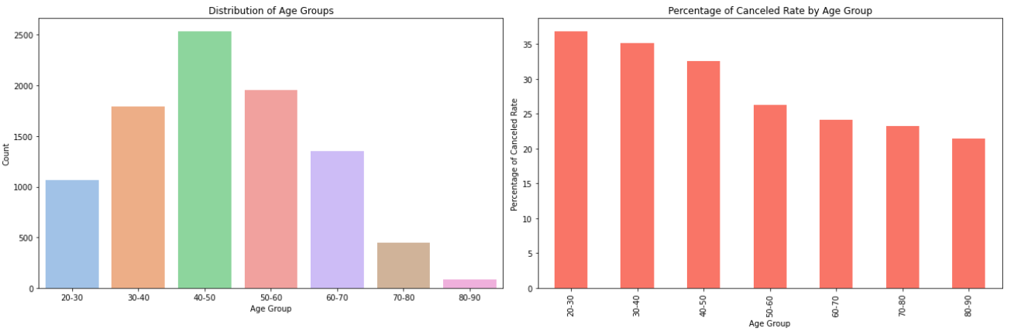
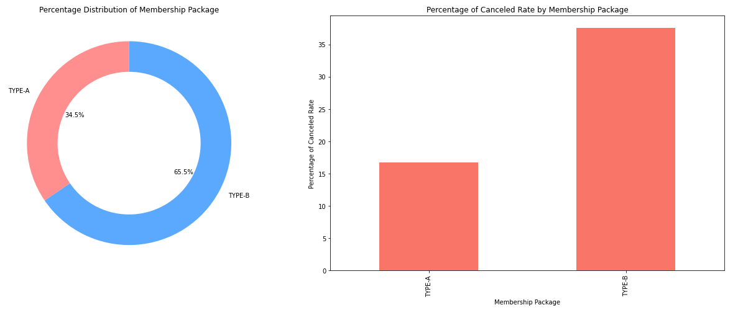
Age group and Package Type
EDA
The majority of members, at the time of joining, fall within the age range of 30 to 60 years.
A noticeable trend is that younger members exhibit a higher inclination towards canceling our service
In response to the hypothesis, the data indeed verifies that members with the TYPE_B package have a noticeably higher churn rate than those with TYPE_A. The cancellation rate for TYPE_B stands out as significantly greater than that of TYPE_A.
Notably, the TYPE_B package is more popular, with the majority of our members opting for it.

Slide 8
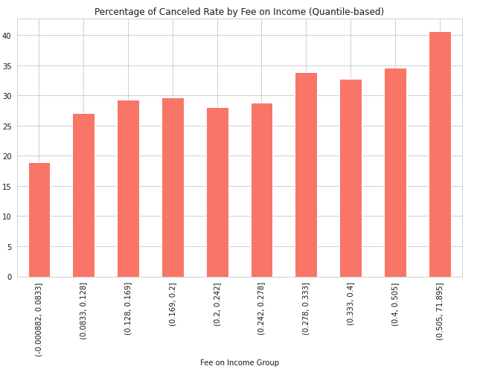
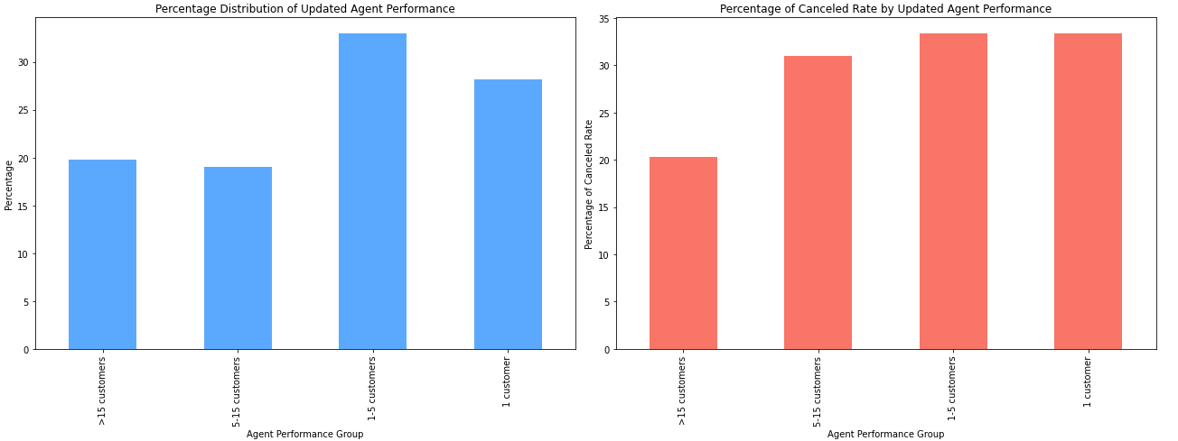
Fee to income ratio and Agent Performance
EDA
The optimal range for annual fees appears to be between 100K and 120K.
To enhance retention, it's advisable to set the annual fee at approximately 10% to 12% of a member's income.
Approximately 20% of our agents are classified as 'high-performing', having successfully onboarded more than 15 members each.
Members introduced by these top-tier agents demonstrate a notably reduced rate of cancellation, underscoring the impact of agent performance on member retention

Slide 9
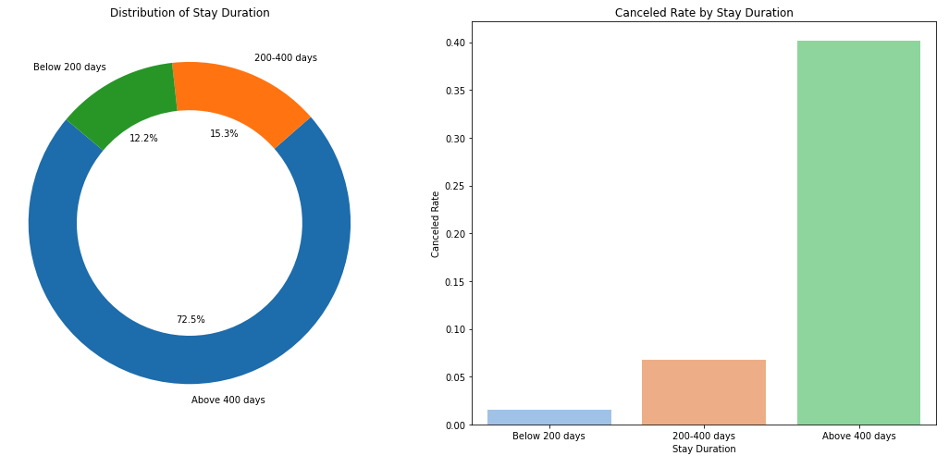
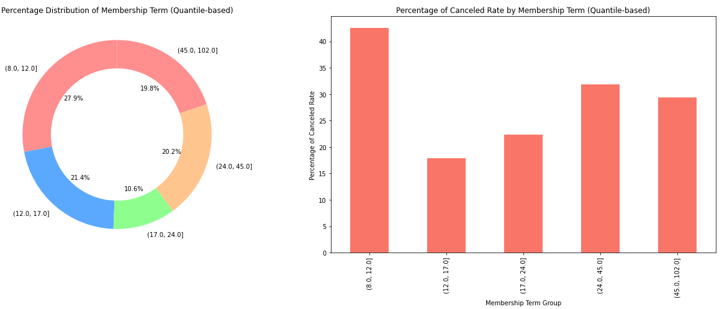
Membership Terms and Member Tenure
EDA
Members with shorter subscription terms tend to have a higher cancellation rate.
Our membership displays an even distribution across various subscription durations
Close to 30% of our members are relatively new, having been with us for less than 400 days. This newer cohort exhibits a markedly lower cancellation rate when compared to the more tenured group that has been with us for more than 400 days

Slide 10

Predictive analytics

Slide 11
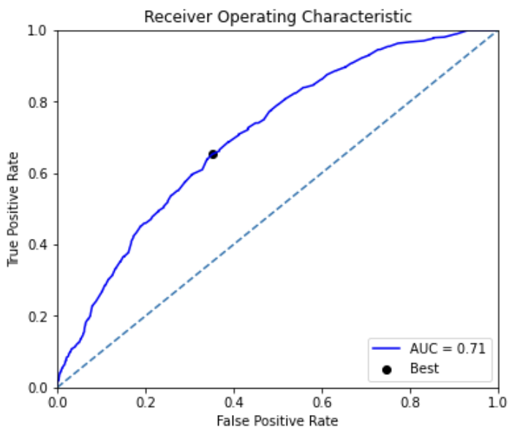
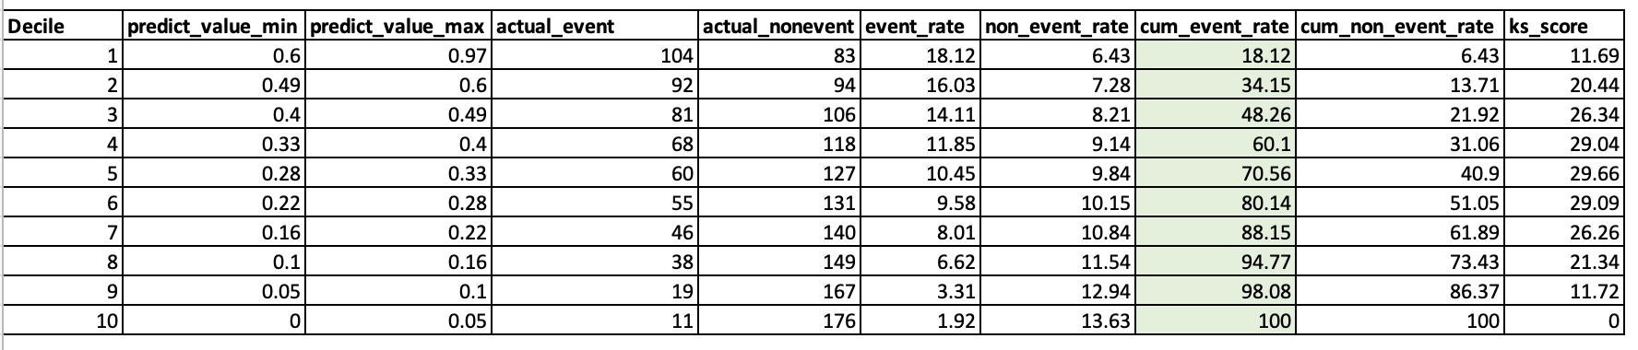
Baseline model
Predictive Analytics
After comparing multiple models, we decided to choose Random Forest in our problem
There is just basic featuring on existing features by filling missing values and encode the categorical with one-hot encoding
With 0.71 AUC and top 40% cover around 60% the event rate.
Note: Find the appendix to see the comparation of model's performance

Slide 12
Model improvement
Predictive Analytics
Add derived features
Baseline model
Embedding categorical features
Final model with 0.81 AUC
Hyperparameters tuning
By adding more derived features, embedding categorical features with deep learning model and search best hyperparameters with grid search
The AUC increase from 0.71 to 0.81 and top 40% covers 71% of event rate.
Note: See more information about the steps on the attached detail document

Slide 13
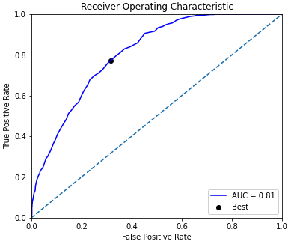
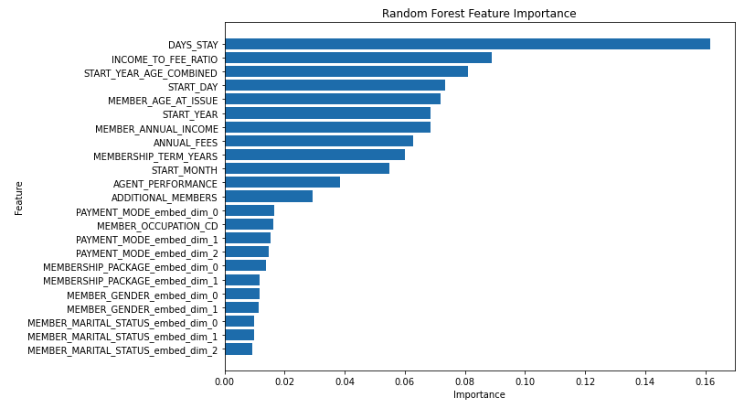
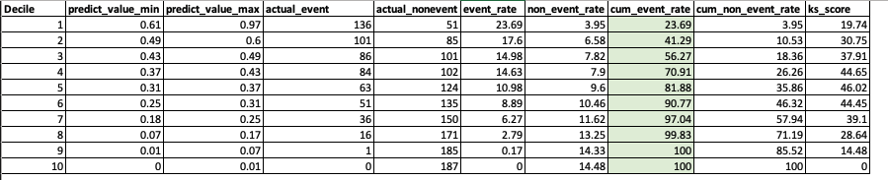
Final model evaluation

Slide 14

Proposed solution deployment

Slide 15
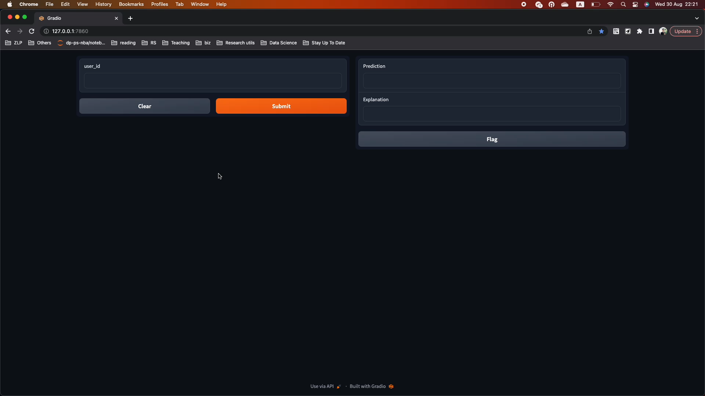
Cancelled prediction with explainer
Solution deployment
We can go further by applying explainers to help the customer service team, for example, know why one member is churned, so that they can have suitable scripts or even customized offer for the users.

Slide 16
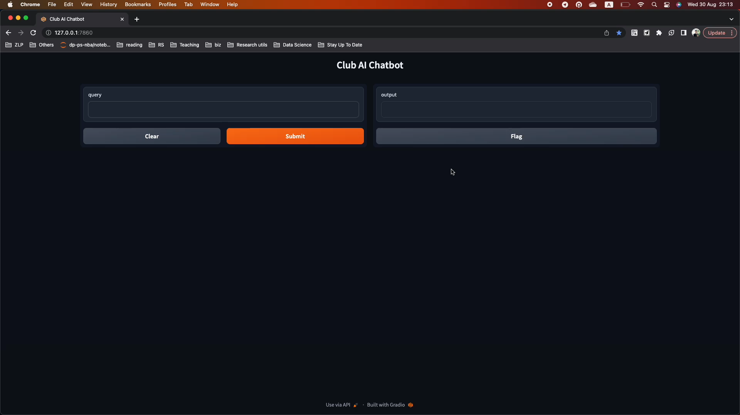
Chatbot assistance
Solution deployment
We can combine the output of cancelled prediction model, explainer as well as our local dataset. With the combination we can apply LLM to build effective chatbot for preventing churn effectively

Slide 17
Conclusion
There are some findings to be noted: Most members join between ages 30-60, with younger ones churning more. TYPE_B, our popular package, has a higher churn than TYPE_A. Ideal annual fees are 100K-120K, with best retention at 10-12% of a member's income. Top 20% agents bring in 15+ members each with their referrals churning less. Short-term members churn more, and newer members, comprising 30% of our base, have lower churn rates
With need derived features added, new way of handling categorical features as well as hyperparameter tuning, we have a model with 0.81 AUC.
Besides traditional approach of using ML, we proposed the alternative approaches which are combining explainer or using LLM to help the business prevent churn effectively.

Slide 18
Appendix

Slide 19
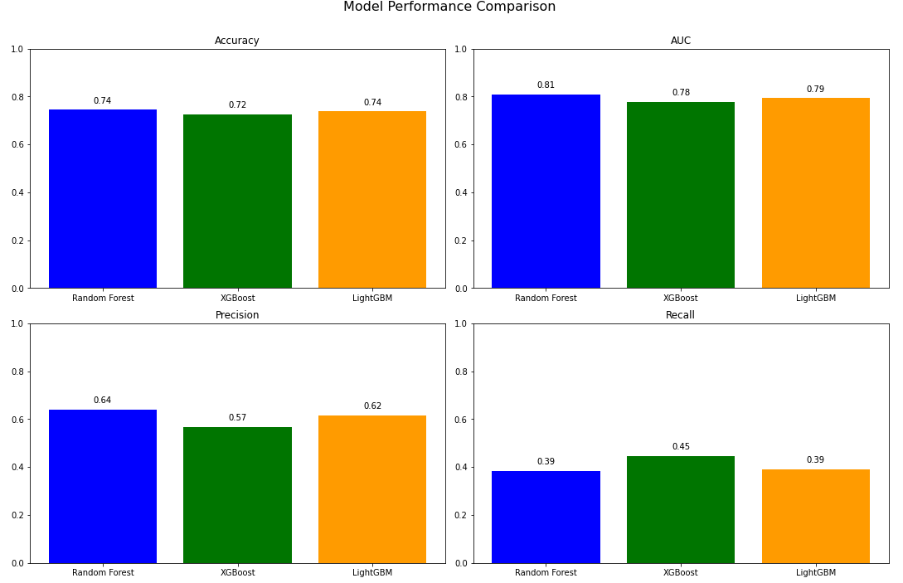
Model comparation
This comparation is the result of best features.

